Slide 1
Computing Full Conformal Prediction Set with Approximate Homotopy
报告人：2020级博士班 徐雯雯
2021年12月8日

Slide 2
Abstract
Conformal prediction methods provide an elegant framework for answering such question by building a 100(1 α)% confidence region without assumptions on the distribution of the data. It is based on a refitting procedure that parses all the possibilities for y to select the most likely ones. Although providing strong coverage guarantees, conformal set is impractical to compute exactly for many regression problems. We propose efficient algorithms to compute conformal prediction set using approximated solution of (convex) regularized empirical risk minimization. Our approaches rely on a new homotopy continuation technique for tracking the solution path with respect to sequential changes of the observations. We also provide a detailed analysis quantifying its complexity.

Slide 3
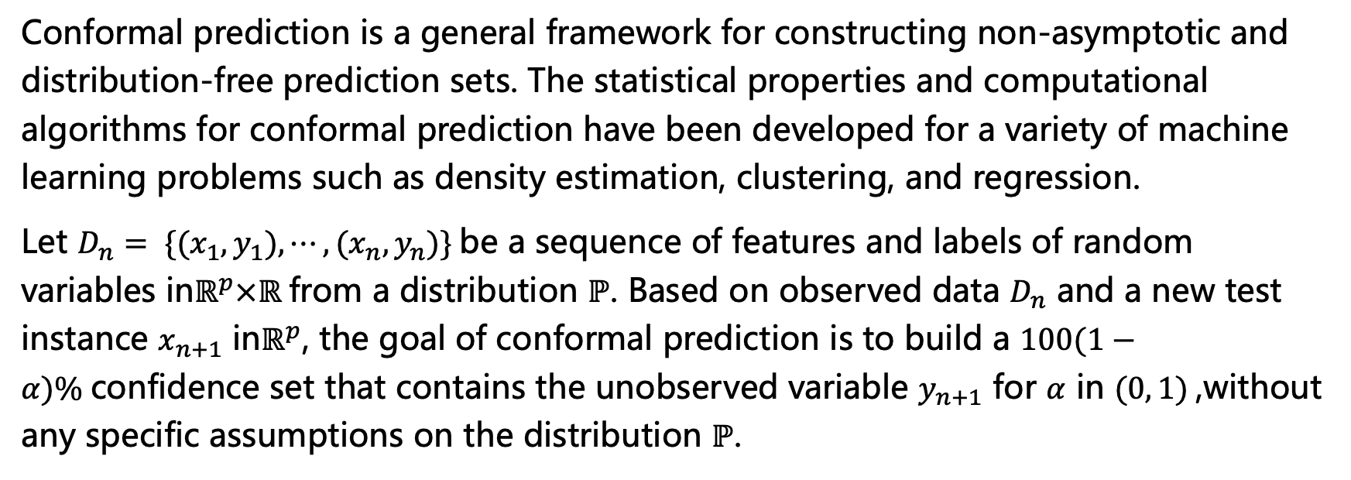
Introduction
Conformal prediction is a general framework for constructing non-asymptotic and distribution-free prediction sets. The statistical properties and computational algorithms for conformal prediction have been developed for a variety of machine learning problems such as density estimation, clustering, and regression.
Let $D_{n}= \{(x_{1},y_{1}), ⋯, (x_{n},y_{n})\}$be a sequence of features and labels of random variables in$ℝ^{p}×ℝ$from a distribution $ℙ$. Based on observed data $D_{n}$ and a new test instance $x_{n+1}$ in$ℝ^{p}$, the goal of conformal prediction is to build a $100(1−α)\%$confidence set that contains the unobserved variable $y_{n+1}$ for $α$ in $(0, 1)$,without any specific assumptions on the distribution $ℙ$.

Slide 4
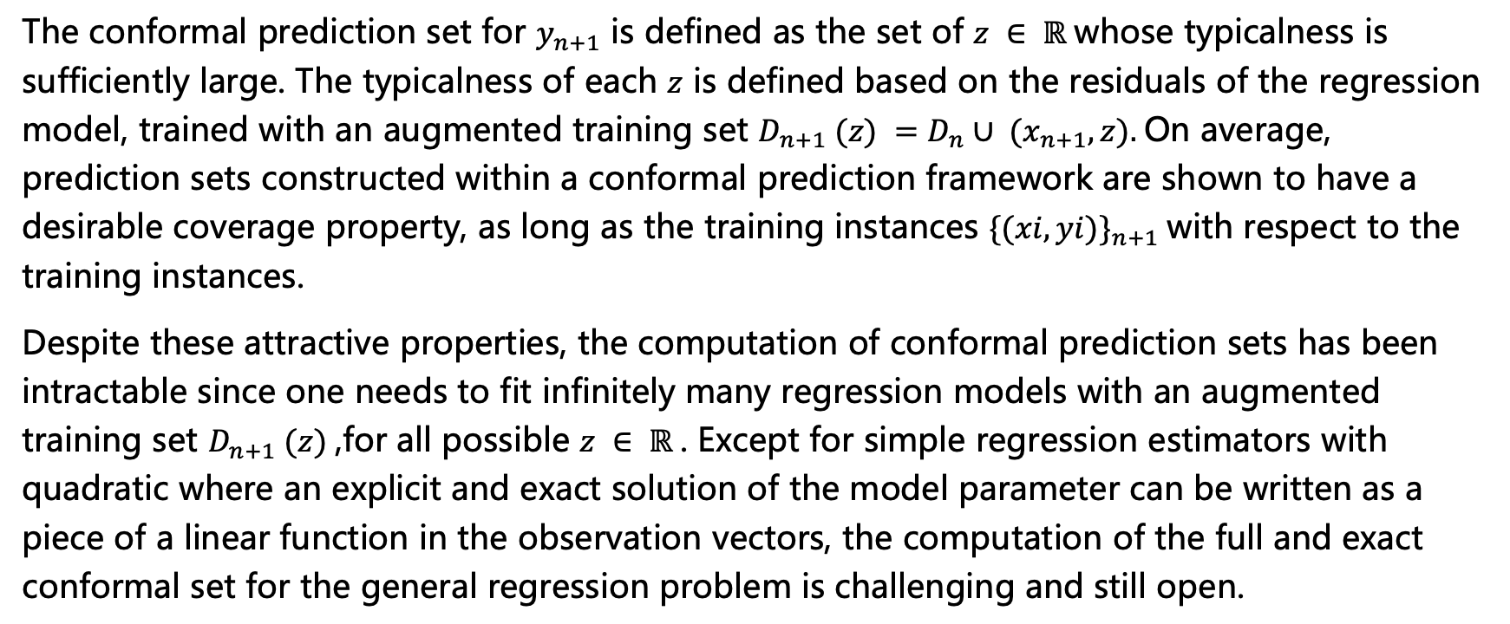
Introduction
The conformal prediction set for $y_{n+1}$ is defined as the set of $z ∈ ℝ$whose typicalness is sufficiently large. The typicalness of each $z$ is defined based on the residuals of the regression model, trained with an augmented training set $D_{n+1} (z) =D_{n}∪ (x_{n+1}, z).$On average, prediction sets constructed within a conformal prediction framework are shown to have a desirable coverage property, as long as the training instances ${\{(xi, yi)\}}_{n+1}$with respect to the training instances.
Despite these attractive properties, the computation of conformal prediction sets has been intractable since one needs to fit infinitely many regression models with an augmented training set $D_{n+1} (z)$,for all possible $z ∈ ℝ$. Except for simple regression estimators with quadratic where an explicit and exact solution of the model parameter can be written as a piece of a linear function in the observation vectors, the computation of the full and exact conformal set for the general regression problem is challenging and still open.

Slide 5
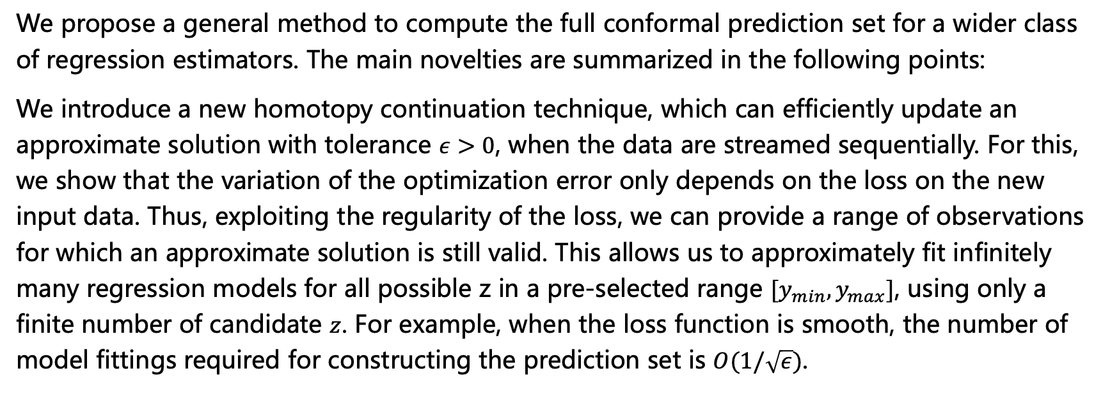
Introduction-Contributions
We propose a general method to compute the full conformal prediction set for a wider class of regression estimators. The main novelties are summarized in the following points:
We introduce a new homotopy continuation technique, which can efficiently update an approximate solution with tolerance $ε>0$, when the data are streamed sequentially. For this, we show that the variation of the optimization error only depends on the loss on the new input data. Thus, exploiting the regularity of the loss, we can provide a range of observations for which an approximate solution is still valid. This allows us to approximately fit infinitely many regression models for all possible z in a pre-selected range $[y_{min},y_{max}]$, using only a finite number of candidate $z$. For example, when the loss function is smooth, the number of model fittings required for constructing the prediction set is $O(1/\sqrt{ε})$.

Slide 6
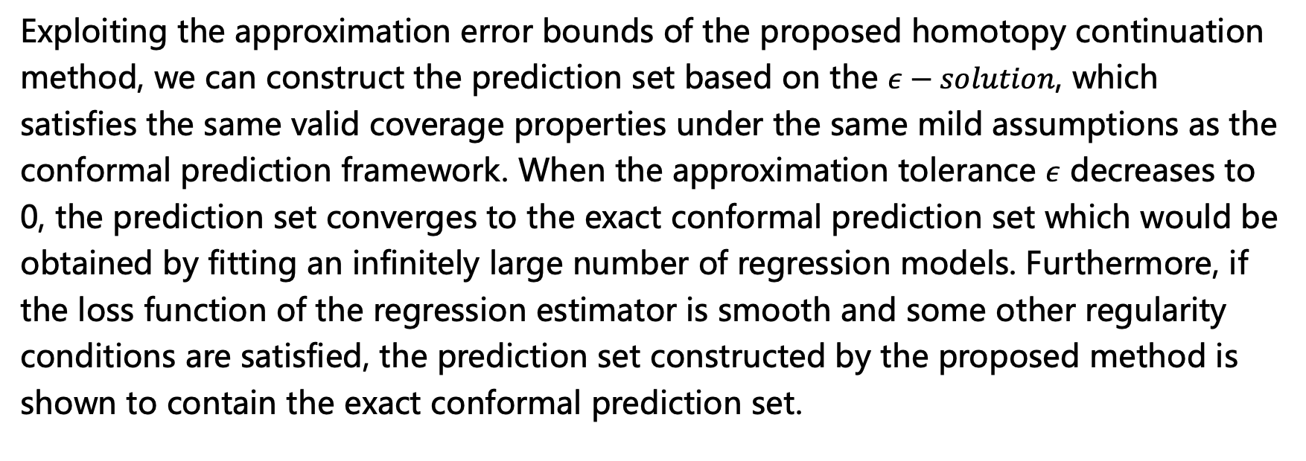
Introduction-Contributions
Exploiting the approximation error bounds of the proposed homotopy continuation method, we can construct the prediction set based on the $ε−solution$, which satisfies the same valid coverage properties under the same mild assumptions as the conformal prediction framework. When the approximation tolerance $ε$ decreases to 0, the prediction set converges to the exact conformal prediction set which would be obtained by fitting an infinitely large number of regression models. Furthermore, if the loss function of the regression estimator is smooth and some other regularity conditions are satisfied, the prediction set constructed by the proposed method is shown to contain the exact conformal prediction set.

Slide 7
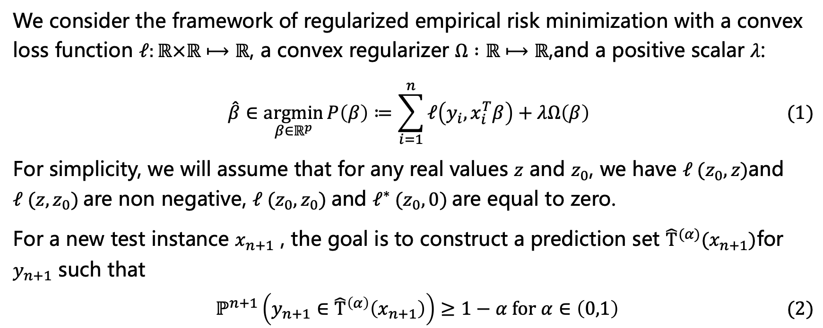
Background
We consider the framework of regularized empirical risk minimization with a convex loss function $ℓ:ℝ×ℝ⟼ℝ$, a convex regularizer $Ω :ℝ⟼ℝ$,and a positive scalar $λ$:
$$\hat{β}∈\underset{β∈ℝ^{p}}{argmin}{P\left(β\right)≔\sum_{i=1}^{n}{ℓ\left(y_{i},x_{i}^{T}β\right)+λΩ\left(β\right)}} (1)$$
For simplicity, we will assume that for any real values $z$ and $z_{0}$, we have $ℓ (z_{0},z)$and $ℓ (z,z_{0})$are non negative, $ℓ (z_{0},z_{0})$and $ℓ^{∗} (z_{0},0)$are equal to zero.
For a new test instance $x_{n+1}$ , the goal is to construct a prediction set ${\hat{Τ}}^{(α)}(x_{n+1})$for $y_{n+1}$ such that
$$ℙ^{n+1}\left(y_{n+1}∈{\hat{Τ}}^{\left(α\right)}\left(x_{n+1}\right)\right)≥1−α for α∈\left(0,1\right) (2)$$

Slide 8
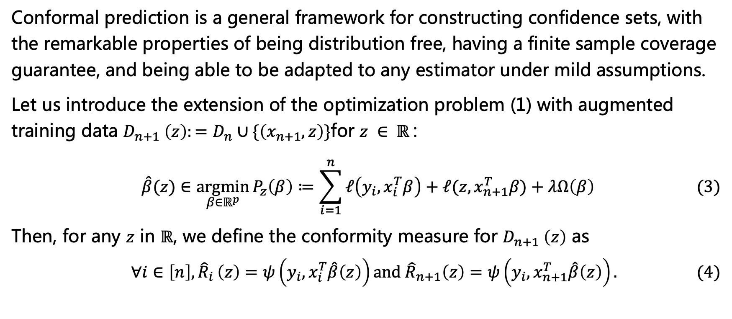
Conformal Prediction
Conformal prediction is a general framework for constructing confidence sets, with the remarkable properties of being distribution free, having a finite sample coverage guarantee, and being able to be adapted to any estimator under mild assumptions.
Let us introduce the extension of the optimization problem (1) with augmented training data $D_{n+1} \left(z\right):=D_{n}∪\{\left(x_{n+1}, z\right)\}$for $z ∈ ℝ$:
$$\hat{β}(z)∈\underset{β∈ℝ^{p}}{argmin}{P_{z}\left(β\right)≔\sum_{i=1}^{n}{ℓ\left(y_{i},x_{i}^{T}β\right)+ℓ(z,x_{n+1}^{T}β)+λΩ\left(β\right)}} (3)$$
Then, for any $z$ in $ℝ$, we define the conformity measure for $D_{n+1} \left(z\right)$ as
$$∀i∈\left[n\right]{,\hat{R}}_{i}\left(z\right)=ψ\left(y_{i},x_{i}^{T}\hat{β}\left(z\right)\right)and {\hat{R}}_{n+1}\left(z\right)=ψ\left(y_{i},x_{n+1}^{T}\hat{β}\left(z\right)\right). (4)$$

Slide 9
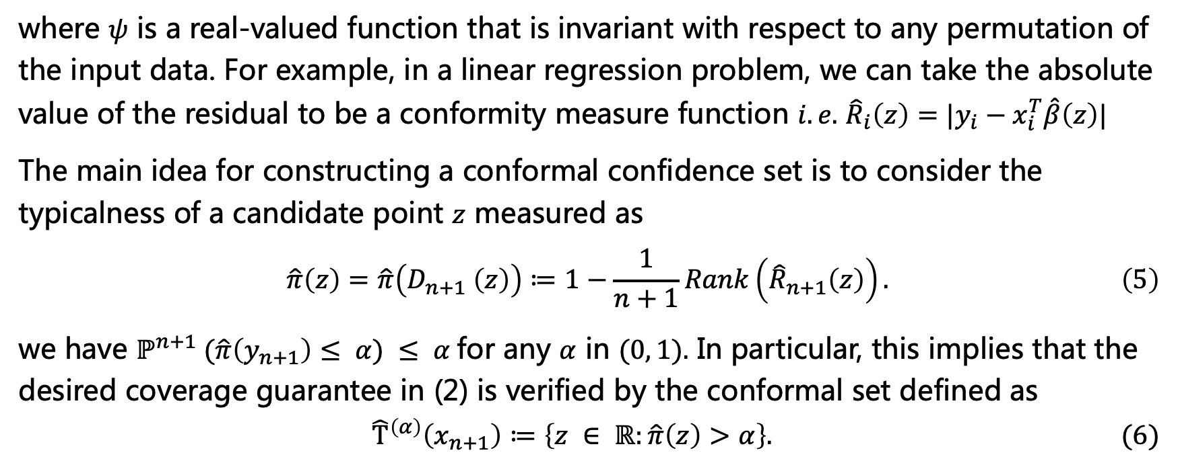
Conformal Prediction
where $ψ$ is a real-valued function that is invariant with respect to any permutation of the input data. For example, in a linear regression problem, we can take the absolute value of the residual to be a conformity measure function $i.e.$ ${\hat{R}}_{i}\left(z\right)=|y_{i}−x_{i}^{T}\hat{β}\left(z\right)|$
The main idea for constructing a conformal confidence set is to consider the typicalness of a candidate point $z$ measured as
$$\hat{π}\left(z\right)=\hat{π}\left(D_{n+1} \left(z\right)\right)≔1−\frac{1}{n+1}Rank\left({\hat{R}}_{n+1}\left(z\right)\right). \left(5\right)$$
we have $ℙ^{n+1} (\hat{π}\left(y_{n+1}\right)≤ α) ≤ α$for any $α$ in $(0, 1).$ In particular, this implies that the desired coverage guarantee in (2) is verified by the conformal set defined as
$${\hat{Τ}}^{\left(α\right)}\left(x_{n+1}\right)≔\left\{z ∈ ℝ:\hat{π}\left(z\right)>α\right\}. (6)$$

Slide 10
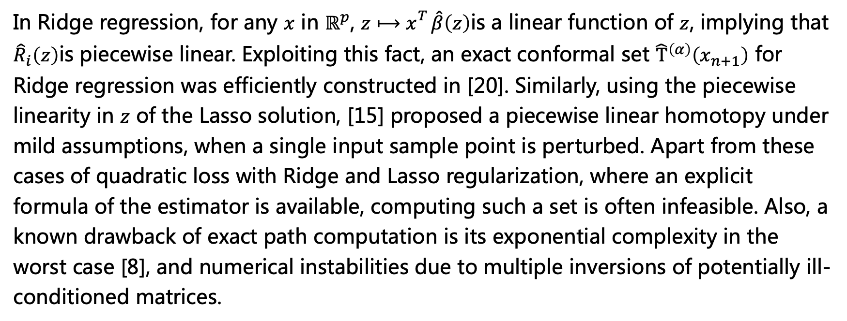
Conformal Prediction- Existing Approaches
In Ridge regression, for any $x$ in $ℝ^{p}$, $z⟼x_{}^{T}\hat{β}\left(z\right)$is a linear function of $z$, implying that ${\hat{R}}_{i}\left(z\right)$is piecewise linear. Exploiting this fact, an exact conformal set ${\hat{Τ}}^{\left(α\right)}\left(x_{n+1}\right)$ for Ridge regression was efficiently constructed in [20]. Similarly, using the piecewise linearity in $z$ of the Lasso solution, [15] proposed a piecewise linear homotopy under mild assumptions, when a single input sample point is perturbed. Apart from these cases of quadratic loss with Ridge and Lasso regularization, where an explicit formula of the estimator is available, computing such a set is often infeasible. Also, a known drawback of exact path computation is its exponential complexity in the worst case [8], and numerical instabilities due to multiple inversions of potentially ill-conditioned matrices.

Slide 11
Conformal Prediction- Existing Approaches
Another approach is to split the dataset into a training set - in which the regression model is fitted, and a calibration set - in which the conformity scores and their ranks are computed. Although this approach avoids the computational bottleneck of the full conformal prediction framework, statistical efficiencies are lost both in the model fitting stage and in the conformity score rank computation stage, due to the effect of a reduced sample size. It also adds another layer of randomness, which may be undesirable for the construction of prediction intervals [15].

Slide 12
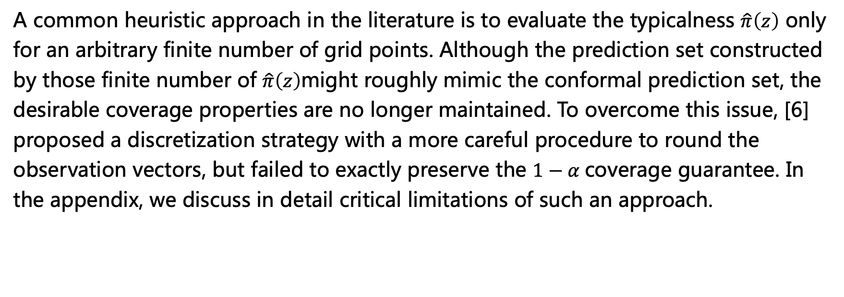
Conformal Prediction- Existing Approaches
A common heuristic approach in the literature is to evaluate the typicalness $\hat{π}\left(z\right)$ only for an arbitrary finite number of grid points. Although the prediction set constructed by those finite number of $\hat{π}\left(z\right)$might roughly mimic the conformal prediction set, the desirable coverage properties are no longer maintained. To overcome this issue, [6] proposed a discretization strategy with a more careful procedure to round the observation vectors, but failed to exactly preserve the $1−α$coverage guarantee. In the appendix, we discuss in detail critical limitations of such an approach.

Slide 13
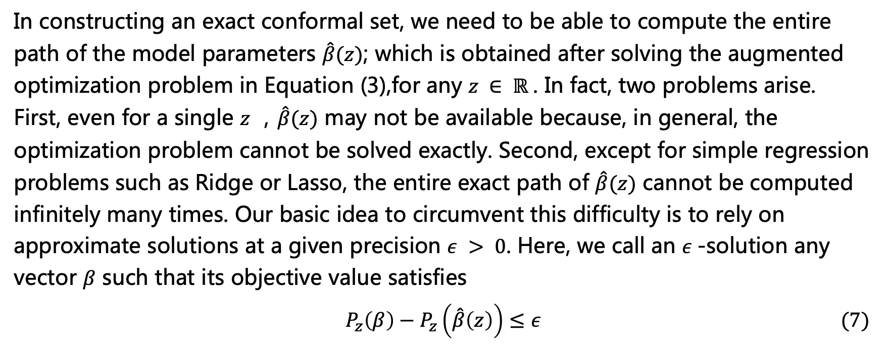
Homotopy Algorithm
In constructing an exact conformal set, we need to be able to compute the entire path of the model parameters $\hat{β}(z)$; which is obtained after solving the augmented optimization problem in Equation (3),for any $z ∈ ℝ$. In fact, two problems arise. First, even for a single $z$ ，$\hat{β}(z)$ may not be available because, in general, the optimization problem cannot be solved exactly. Second, except for simple regression problems such as Ridge or Lasso, the entire exact path of $\hat{β}(z)$ cannot be computed infinitely many times. Our basic idea to circumvent this difficulty is to rely on approximate solutions at a given precision $ε > 0$. Here, we call an $ε$-solution any vector $β$ such that its objective value satisfies
$$P_{z}\left(β\right)−P_{z}\left(\hat{β}\left(z\right)\right)≤ε (7)$$

Slide 14
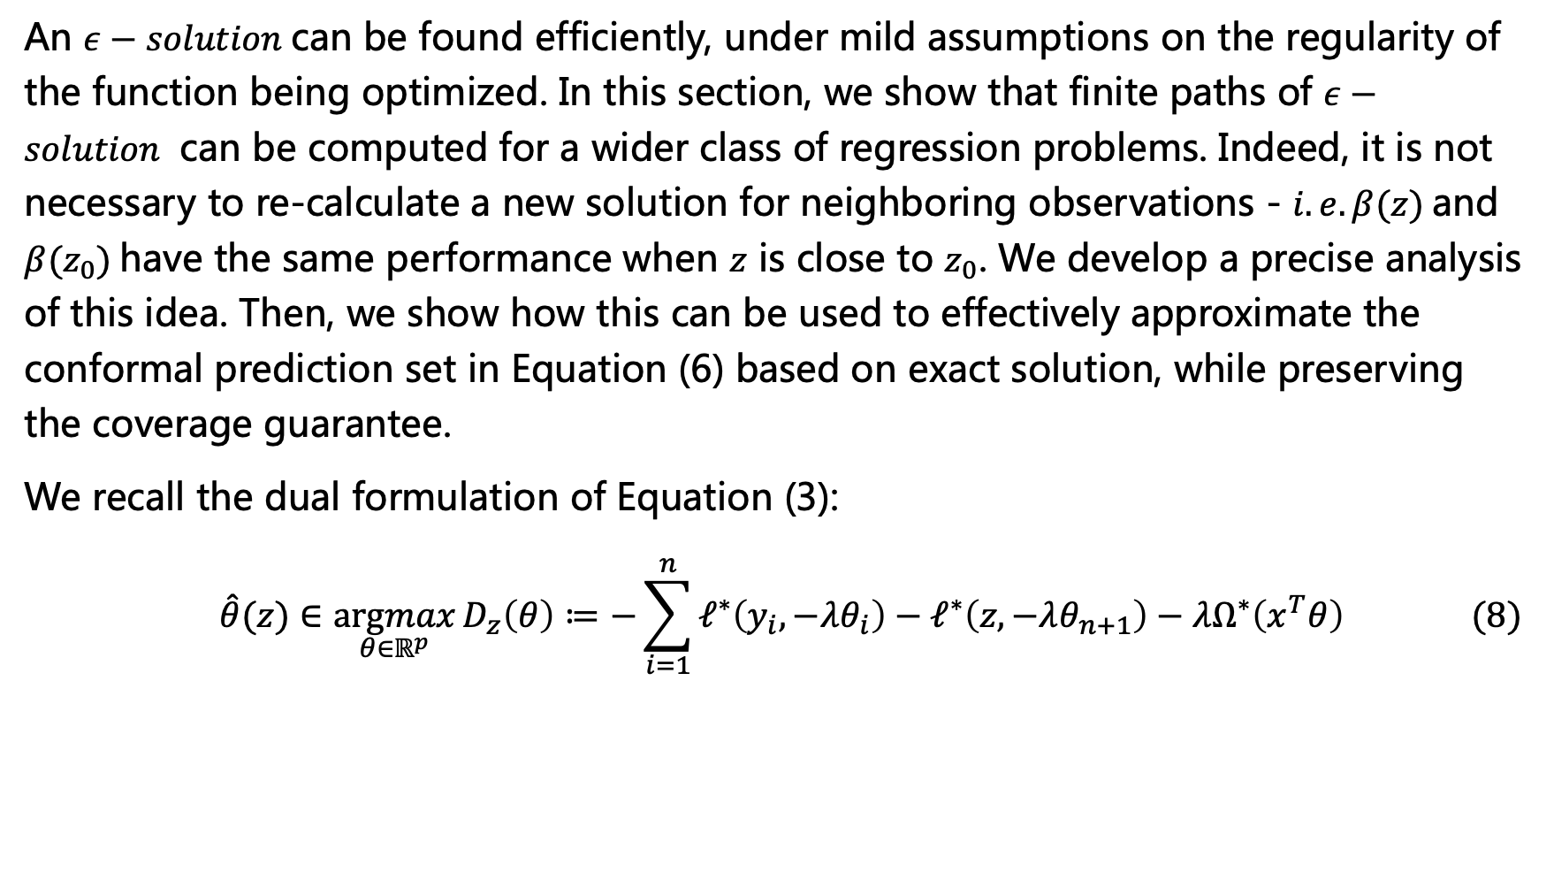
Homotopy Algorithm
An $ε−solution$can be found efficiently, under mild assumptions on the regularity of the function being optimized. In this section, we show that finite paths of $ε−solution$ can be computed for a wider class of regression problems. Indeed, it is not necessary to re-calculate a new solution for neighboring observations - $i.e. β(z)$and $β(z_{0})$have the same performance when $z$ is close to $z_{0}$. We develop a precise analysis of this idea. Then, we show how this can be used to effectively approximate the conformal prediction set in Equation (6) based on exact solution, while preserving the coverage guarantee.
We recall the dual formulation of Equation (3):
$$\hat{θ}(z)∈\underset{θ∈ℝ^{p}}{argmax}{D_{z}\left(θ\right)≔−\sum_{i=1}^{n}{ℓ^{∗}\left(y_{i},−λθ_{i}\right)−ℓ^{∗}\left(z,−λθ_{n+1}\right)−λΩ^{∗}\left(x^{T}θ\right)}} (8)$$

Slide 15
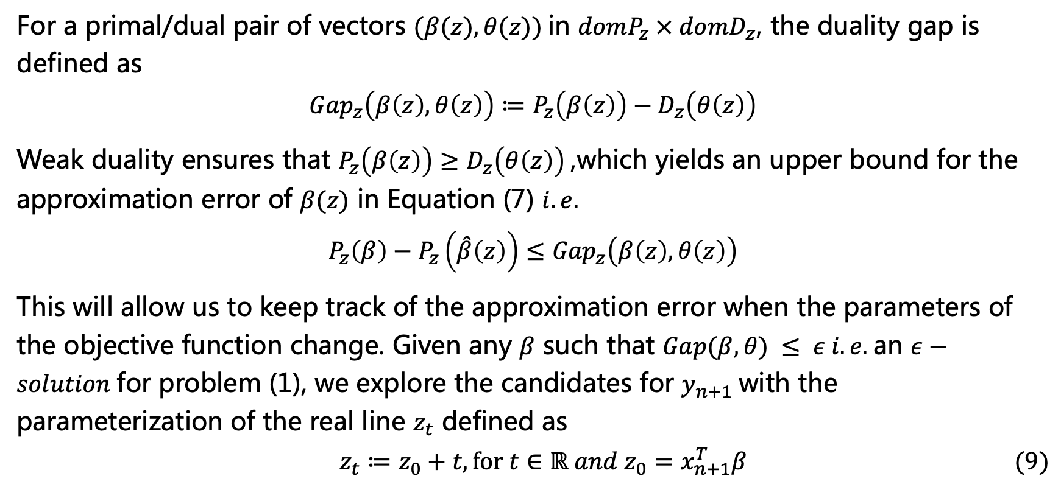
Homotopy Algorithm
For a primal/dual pair of vectors $(β(z), θ(z))$in $domP_{z} × domD_{z}$, the duality gap is defined as
$${Gap}_{z}\left(β\left(z\right), θ\left(z\right)\right)≔P_{z}\left(β\left(z\right)\right)−D_{z}\left(θ\left(z\right)\right)$$
Weak duality ensures that $P_{z}\left(β\left(z\right)\right)≥D_{z}\left(θ\left(z\right)\right)$,which yields an upper bound for the approximation error of $β(z)$ in Equation (7) $i.e.$
$$P_{z}\left(β\right)−P_{z}\left(\hat{β}\left(z\right)\right)≤{Gap}_{z}\left(β\left(z\right), θ\left(z\right)\right)$$
This will allow us to keep track of the approximation error when the parameters of the objective function change. Given any $β$ such that $Gap(β, θ) ≤ ε i.e.$an $ε−solution$for problem (1), we explore the candidates for $y_{n+1}$with the parameterization of the real line $z_{t}$ defined as
$$z_{t}≔z_{0}+t,for t∈ℝ and{ z}_{0}=x_{n+1}^{T}β (9)$$

Slide 16
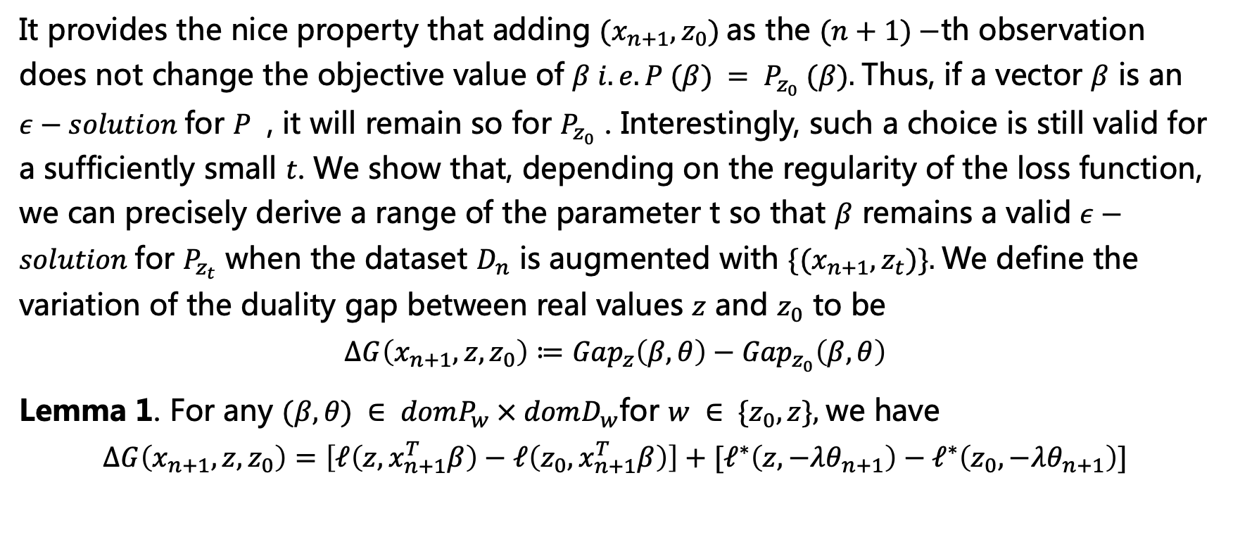
Homotopy Algorithm
It provides the nice property that adding $(x_{n+1}, z_{0})$as the $(n+1)−$th observation does not change the objective value of $β i.e. P (β) = P_{z_{0}} (β).$Thus, if a vector $β$ is an $ε−solution$for $P$ , it will remain so for $P_{z_{0}}$ . Interestingly, such a choice is still valid for a sufficiently small $t$. We show that, depending on the regularity of the loss function, we can precisely derive a range of the parameter t so that $β$ remains a valid $ε−solution$for $P_{z_{t}}$ when the dataset $D_{n}$ is augmented with $\{(x_{n+1}, z_{t})\}.$We define the variation of the duality gap between real values $z$ and $z_{0}$ to be
$$∆G\left(x_{n+1},z,z_{0}\right)≔{Gap}_{z}\left(β, θ\right)−{Gap}_{z_{0}}\left(β, θ\right)$$
Lemma 1. For any $(β, θ) ∈ domP_{w} × domD_{w}$for $w ∈ \{z_{0}, z\},$we have
$$∆G\left(x_{n+1},z,z_{0}\right)=\left[ℓ\left(z,x_{n+1}^{T}β\right)−ℓ\left(z_{0},x_{n+1}^{T}β\right)\right]+[ℓ^{∗}\left(z,−λθ_{n+1}\right)−ℓ^{∗}\left(z_{0},−λθ_{n+1}\right)]$$

Slide 17
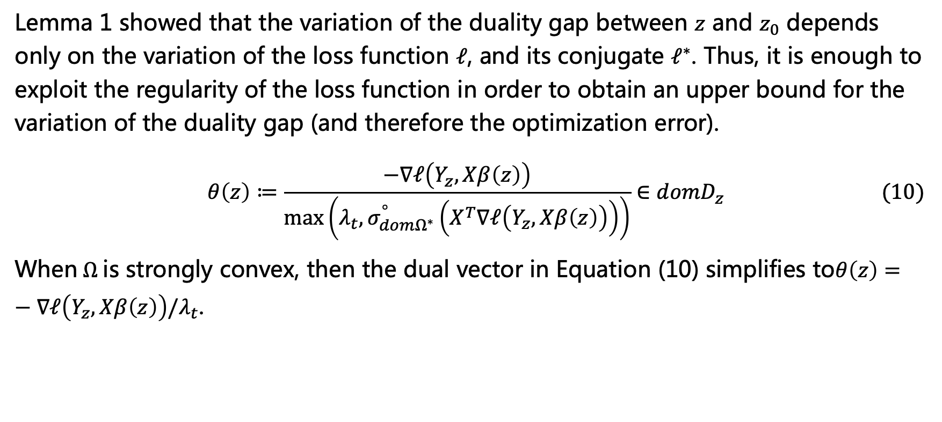
Homotopy Algorithm
Lemma 1 showed that the variation of the duality gap between $z$ and $z_{0}$ depends only on the variation of the loss function $ℓ$, and its conjugate $ℓ^{∗}$. Thus, it is enough to exploit the regularity of the loss function in order to obtain an upper bound for the variation of the duality gap (and therefore the optimization error).
$$θ\left(z\right)≔\frac{−∇ℓ\left(Y_{z},Xβ\left(z\right)\right)}{\max\left(λ_{t},σ_{domΩ^{∗}}^{°}\left(X^{T}∇ℓ\left(Y_{z},Xβ\left(z\right)\right)\right)\right)}∈domD_{z} (10)$$
When$Ω$is strongly convex, then the dual vector in Equation (10) simplifies to$θ\left(z\right)=−∇ℓ\left(Y_{z},Xβ\left(z\right)\right)/λ_{t}$.

Slide 18
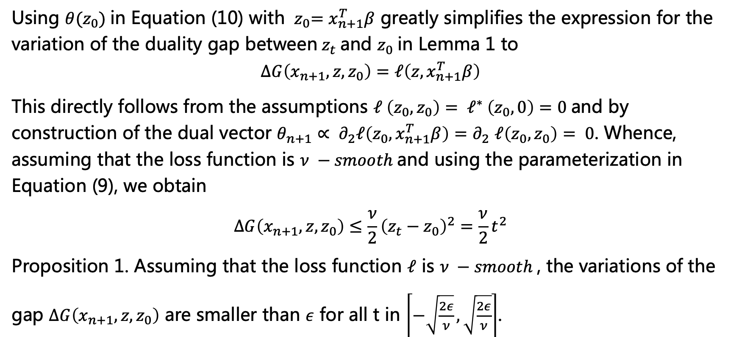
Homotopy Algorithm
Using $θ(z_{0})$in Equation (10) with ${ z}_{0}=x_{n+1}^{T}β$ greatly simplifies the expression for the variation of the duality gap between${ z}_{t}$and $z_{0}$in Lemma 1 to
$$∆G\left(x_{n+1},z,z_{0}\right)=ℓ\left(z,x_{n+1}^{T}β\right)$$
This directly follows from the assumptions $ℓ \left(z_{0},z_{0}\right)= ℓ^{∗} \left(z_{0},0\right)=0$and by construction of the dual vector $θ_{n+1}∝ ∂_{2}ℓ\left(z_{0},x_{n+1}^{T}β\right){=∂}_{2}ℓ\left(z_{0},z_{0}\right)= 0$. Whence, assuming that the loss function is $ν −smooth$and using the parameterization in Equation (9), we obtain
$$∆G\left(x_{n+1},z,z_{0}\right)≤\frac{ν}{2}{\left(z_{t}−z_{0}\right)}^{2}=\frac{ν}{2}t^{2}$$
Proposition 1. Assuming that the loss function $ℓ$ is $ν −smooth$, the variations of the gap $∆G\left(x_{n+1},z,z_{0}\right)$ are smaller than $ε$ for all t in $\left[−\sqrt{\frac{2ε}{ν}},\sqrt{\frac{2ε}{ν}}\right]$.

Slide 19
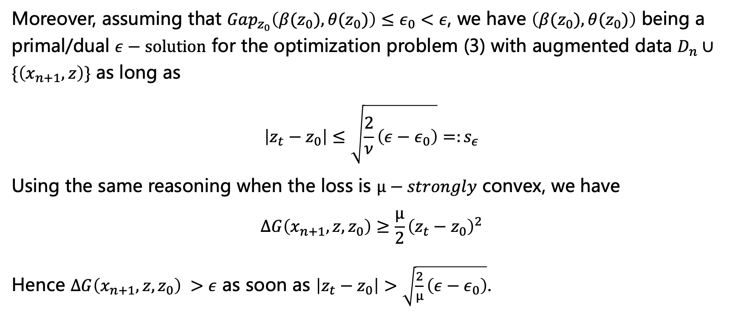
Homotopy Algorithm
Moreover, assuming that ${Gap}_{z_{0}}\left(β(z_{0}), θ(z_{0})\right)≤ε_{0}<ε$, we have $\left(β(z_{0}), θ(z_{0})\right)$ being a primal/dual $ε−solution$ for the optimization problem (3) with augmented data $D_{n}∪\{\left(x_{n+1}, z\right)\}$ as long as
$$\left|z_{t}−z_{0}\right|≤\sqrt{\frac{2}{ν}\left(ε−ε_{0}\right)}=:s_{ε}$$
Using the same reasoning when the loss is $µ−strongly$ convex, we have
$$∆G\left(x_{n+1},z,z_{0}\right)≥\frac{µ}{2}{\left(z_{t}−z_{0}\right)}^{2}$$
Hence $∆G\left(x_{n+1},z,z_{0}\right) >ε$ as soon as $\left|z_{t}−z_{0}\right|>\sqrt{\frac{2}{µ}\left(ε−ε_{0}\right)}$.

Slide 20
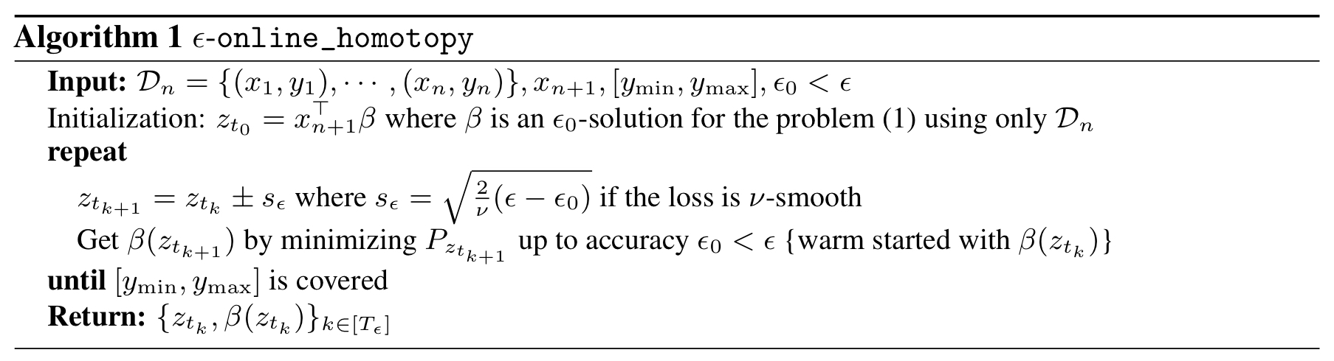
Homotopy Algorithm

Slide 21
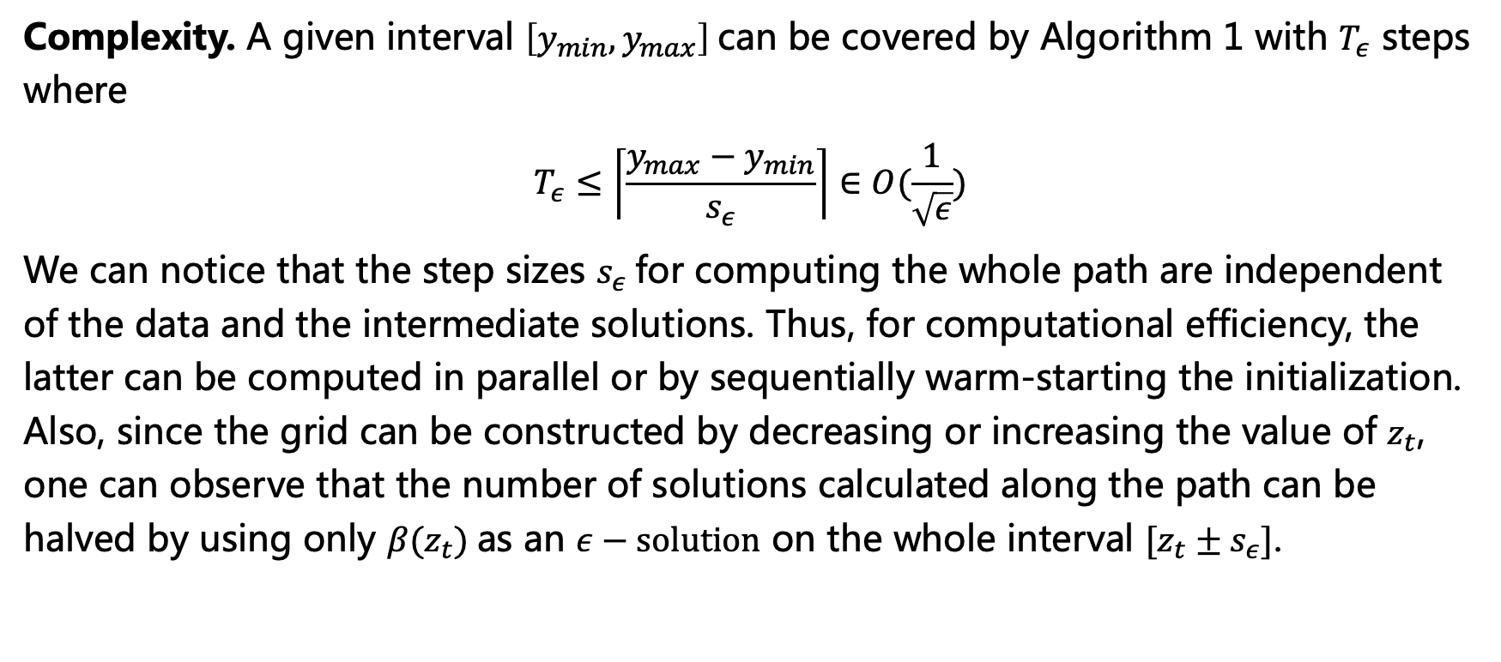
Homotopy Algorithm
Complexity. A given interval $\left[y_{min},y_{max}\right]$can be covered by Algorithm 1 with $T_{ε}$ steps where
$$T_{ε}≤\left\lceil \frac{{y_{max}−y}_{min}}{s_{ε}}\right\rceil ∈O(\frac{1}{\sqrt{ε}})$$
We can notice that the step sizes $s_{ε}$for computing the whole path are independent of the data and the intermediate solutions. Thus, for computational efficiency, the latter can be computed in parallel or by sequentially warm-starting the initialization. Also, since the grid can be constructed by decreasing or increasing the value of $z_{t}$, one can observe that the number of solutions calculated along the path can be halved by using only $β(z_{t})$as an $ε−solution$ on the whole interval $[z_{t}±s_{ε}]$.

Slide 22
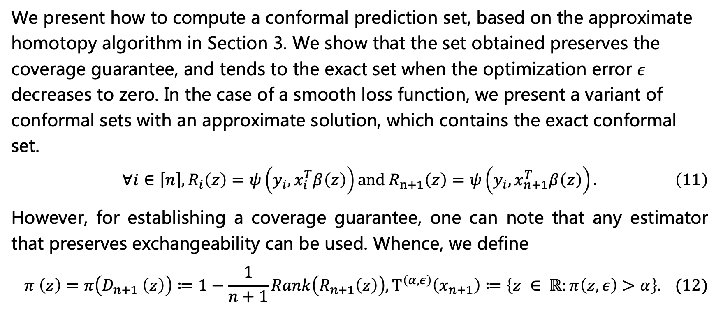
Practical Computation
We present how to compute a conformal prediction set, based on the approximate homotopy algorithm in Section 3. We show that the set obtained preserves the coverage guarantee, and tends to the exact set when the optimization error $ε$ decreases to zero. In the case of a smooth loss function, we present a variant of conformal sets with an approximate solution, which contains the exact conformal set.
$$∀i∈\left[n\right],R_{i}\left(z\right)=ψ\left(y_{i},x_{i}^{T}β\left(z\right)\right)and R_{n+1}\left(z\right)=ψ\left(y_{i},x_{n+1}^{T}β\left(z\right)\right). \left(11\right)$$
However, for establishing a coverage guarantee, one can note that any estimator that preserves exchangeability can be used. Whence, we define
$$π \left(z\right)=π\left(D_{n+1} \left(z\right)\right)≔1−\frac{1}{n+1}Rank\left(R_{n+1}\left(z\right)\right),Τ^{\left(α,ε\right)}\left(x_{n+1}\right)≔\left\{z ∈ ℝ:π\left(z,ε\right)>α\right\}. (12)$$

Slide 23
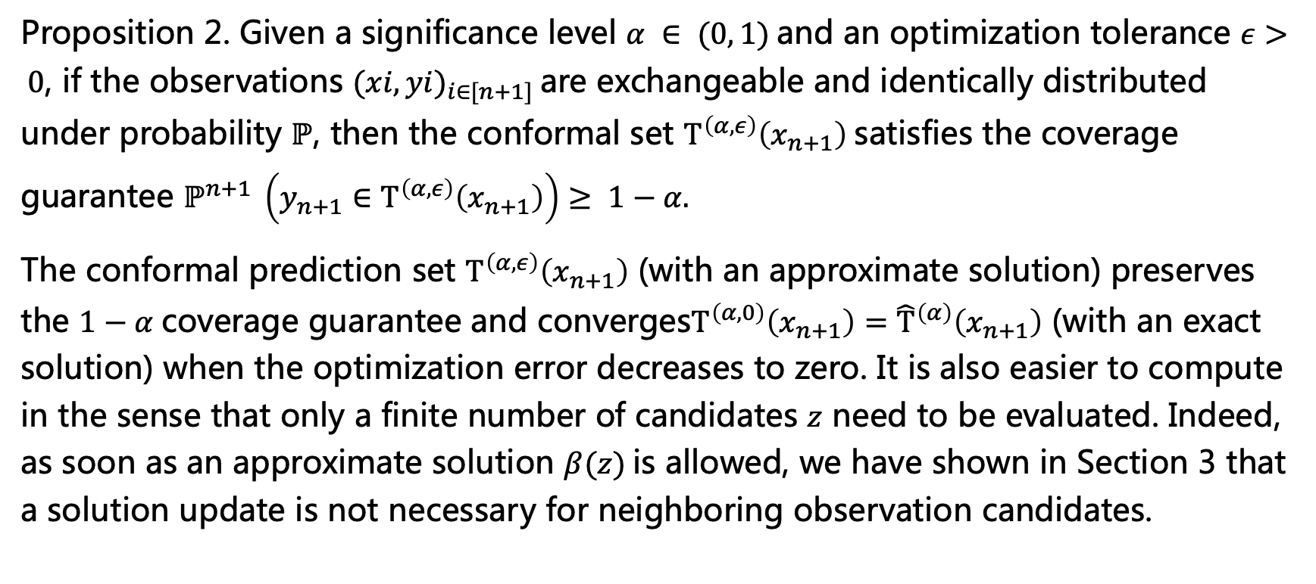
Practical Computation
Proposition 2. Given a significance level $α ∈ (0, 1)$and an optimization tolerance $ε> 0$, if the observations ${(xi, yi)}_{i∈[n+1]}$are exchangeable and identically distributed under probability $ℙ$, then the conformal set $Τ^{\left(α,ε\right)}\left(x_{n+1}\right)$satisfies the coverage guarantee $ℙ^{n+1} \left(y_{n+1}∈Τ^{\left(α,ε\right)}\left(x_{n+1}\right)\right)≥ 1−α.$
The conformal prediction set $Τ^{\left(α,ε\right)}\left(x_{n+1}\right)$ (with an approximate solution) preserves the $1−α$coverage guarantee and converges$Τ^{\left(α,0\right)}\left(x_{n+1}\right)={\hat{Τ}}^{\left(α\right)}\left(x_{n+1}\right)$ (with an exact solution) when the optimization error decreases to zero. It is also easier to compute in the sense that only a finite number of candidates $z$ need to be evaluated. Indeed, as soon as an approximate solution $β(z)$is allowed, we have shown in Section 3 that a solution update is not necessary for neighboring observation candidates.

Slide 24
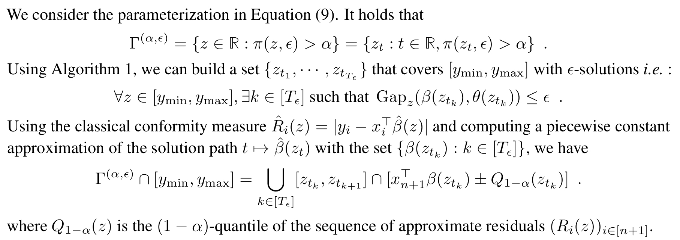
Practical Computation

Slide 25
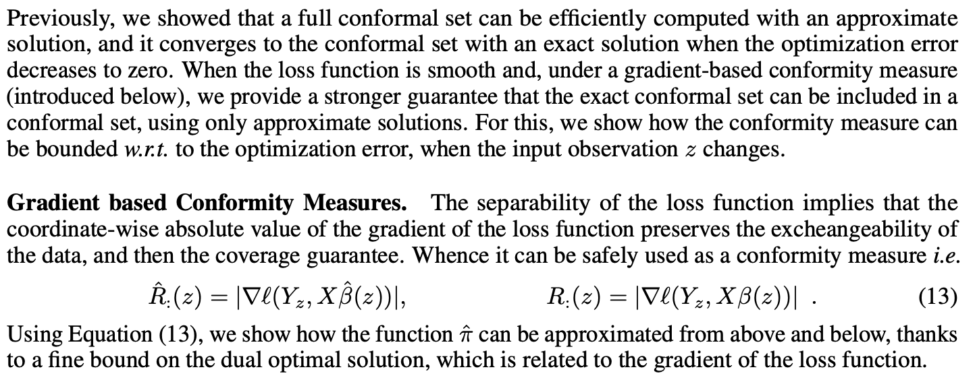
Practical Computation

Slide 26
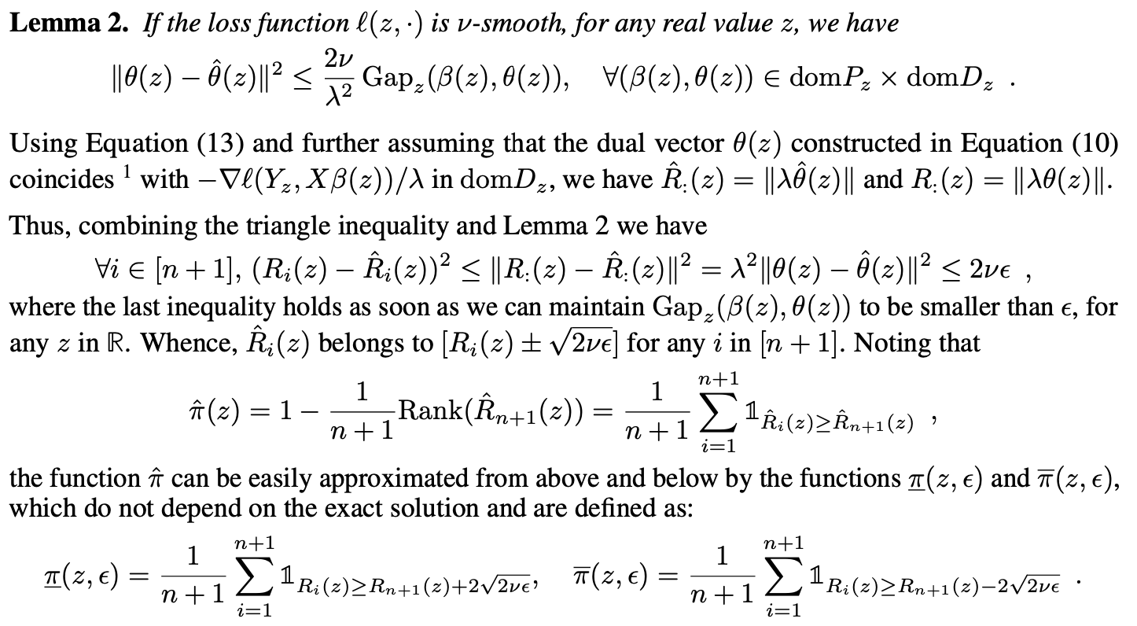
Practical Computation

Slide 27
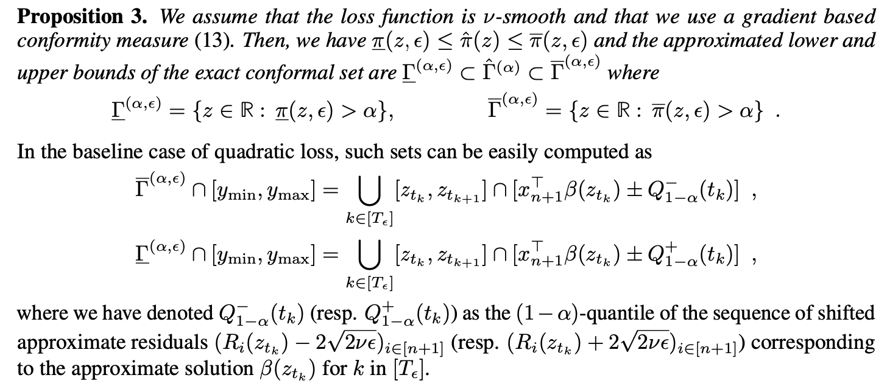
Practical Computation

Slide 28
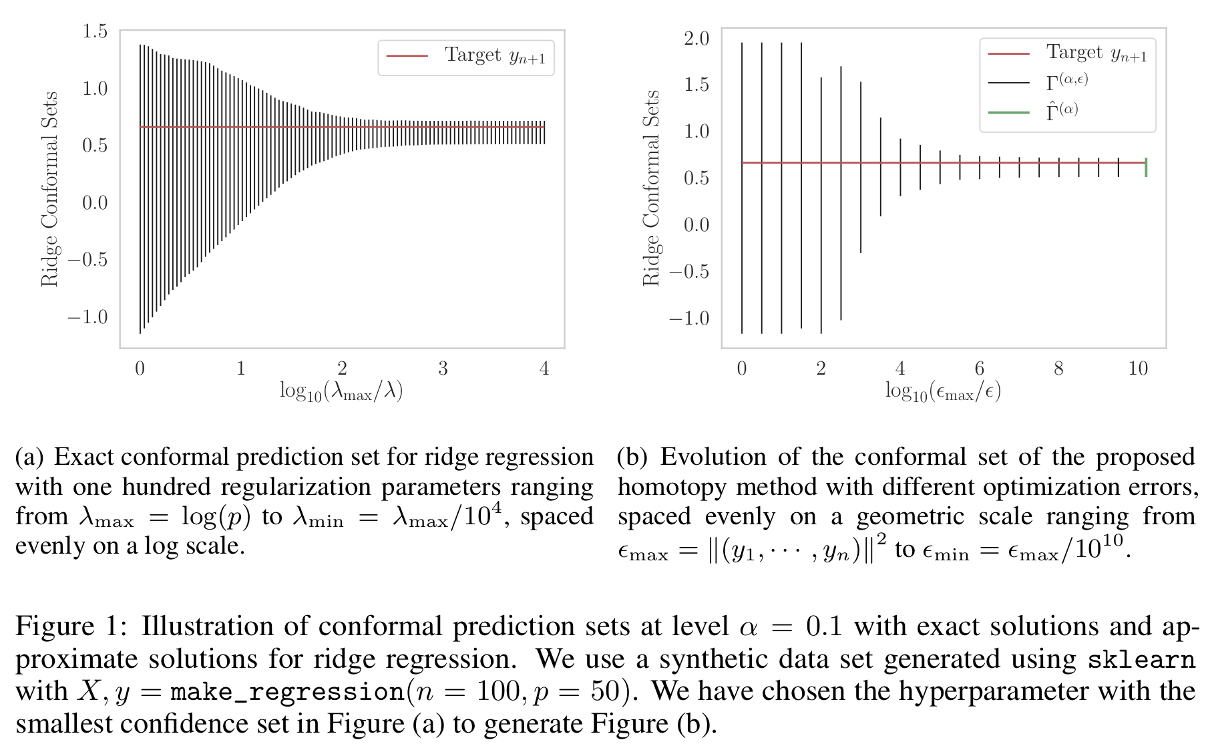
Numerical Experiments

Slide 29
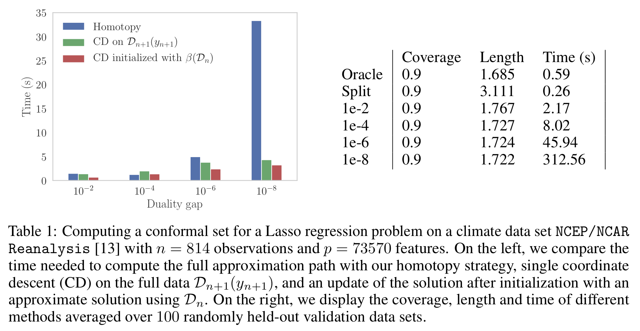
Numerical Experiments

Slide 30
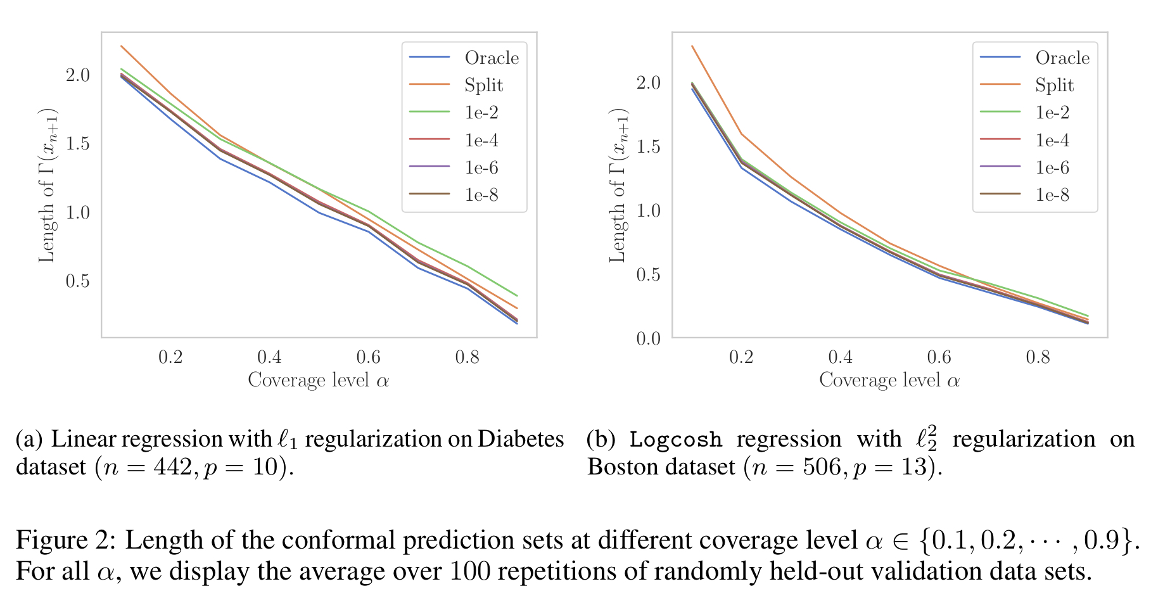
Numerical Experiments

Slide 31
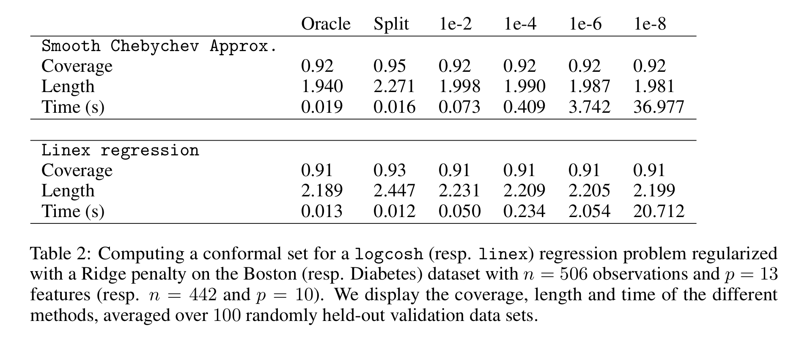
Numerical Experiments

